Slide 1
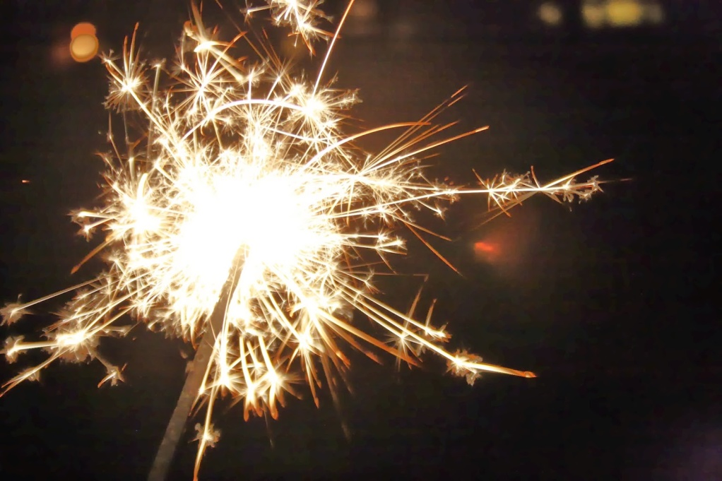
Bonfire Night
Remember, remember
The fifth of November, Gunpowder , treason and plot. We see no reason Why gunpowder treason Should ever be forgot!

Slide 2
Guy Fawkes Night
Bonfire Night
Fireworks Night
is the traditional celebration of the UK (but not an official holiday) on the night of November 5.

Slide 3
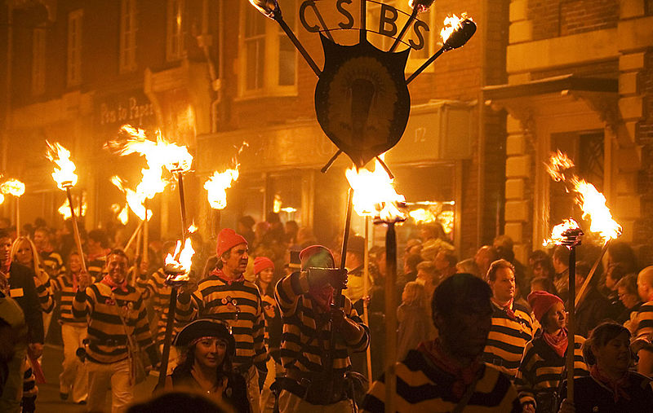
Celebrations in London

Slide 4
The plot

Slide 5
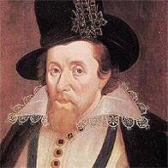
1603
James I became King of England
He fined Catholics for not attending Church of England.

Slide 6
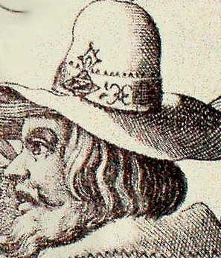
Robert Catsbey was a major leader and organizer of the Gunpowder Plot

Slide 7
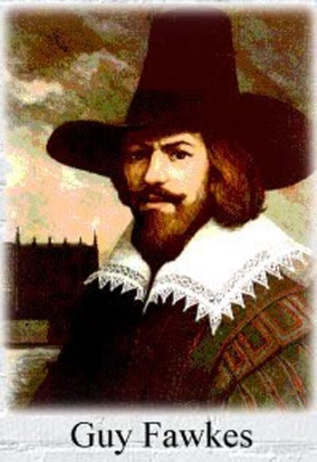
The plotters recruited Guido (Guy) Fawkes, an explosives expert.

Slide 8
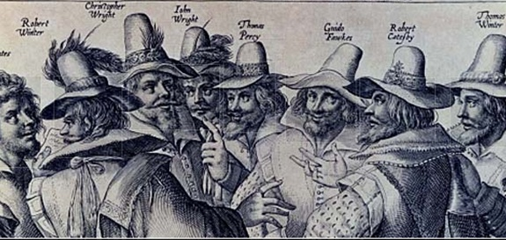
The plotters
Guy Fawkes
Robert Catesby

Slide 9
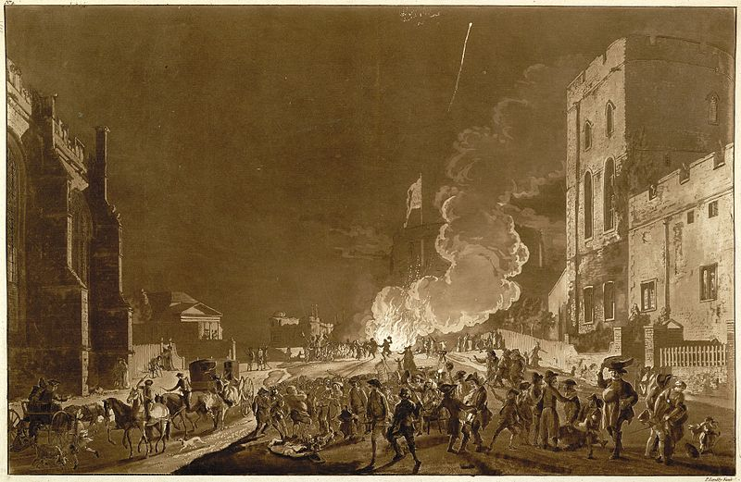
A group of Catholics wanted to blow up the British Parliament in London on the night of November 5, 1605.

Slide 10
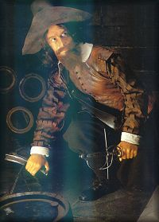
The plan takes shape
36 barrels of gunpowder were secretly moved to the cellar.

Slide 11
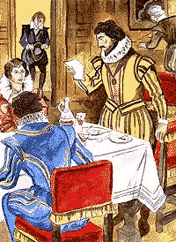
One of the participants warned royal Lord William Parker, and said that he should did not come the next day at the Westminster Palace.

Slide 12
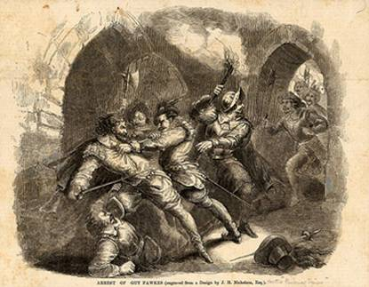
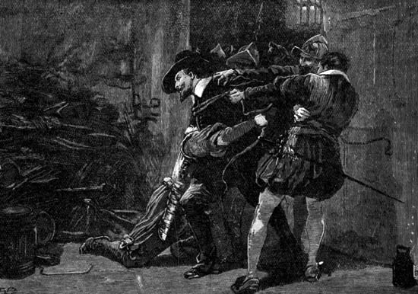
The lord decided to save the royal life.
He warned the king, and the next day, Guy was arrested and taken into the Tower.

Slide 13
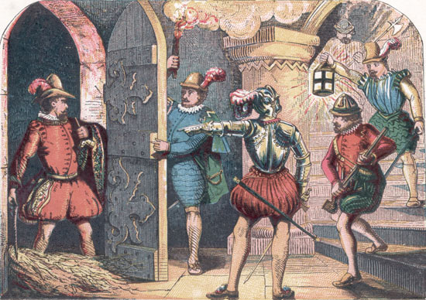

Slide 14
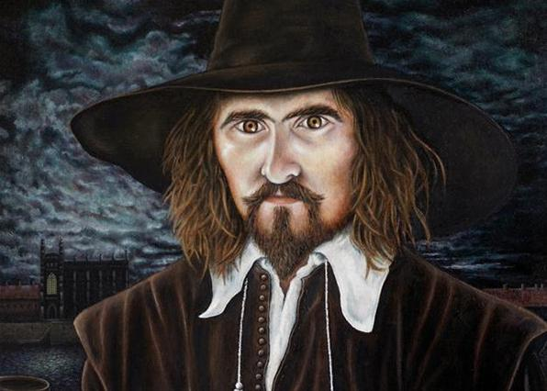
"If you took me inside the building, I would blow up you, myself, and the whole building“
Guy Fawkes

Slide 15
Bonfire night 1776

Slide 16
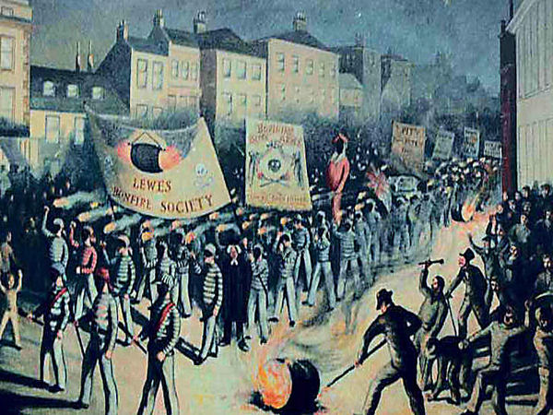
Bonfire Night 1853

Slide 17
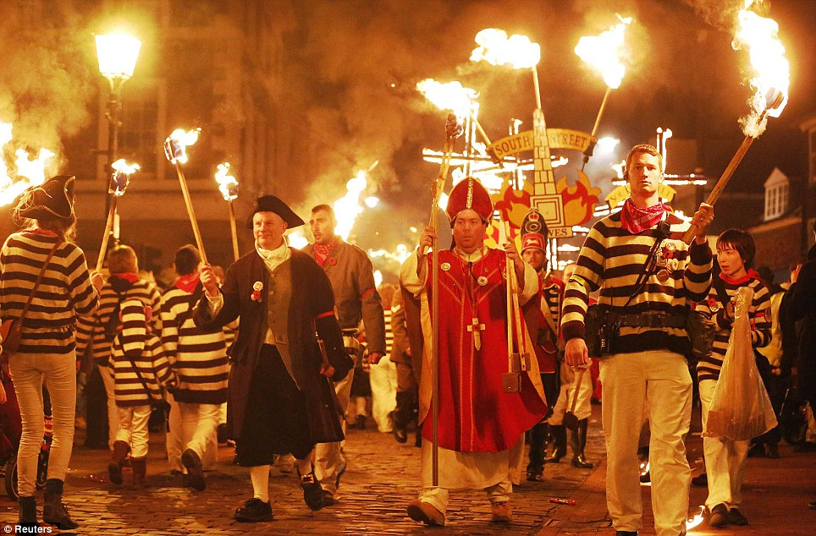
Nowadays

Slide 18
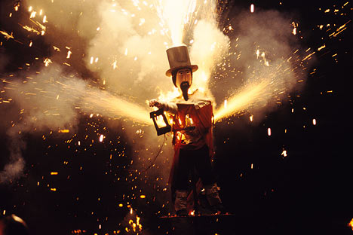
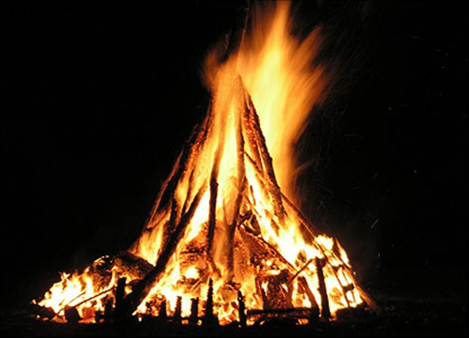
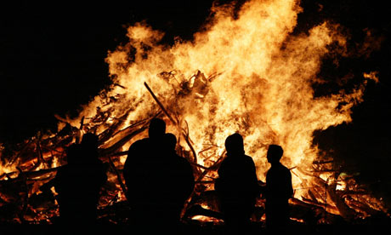

Slide 19
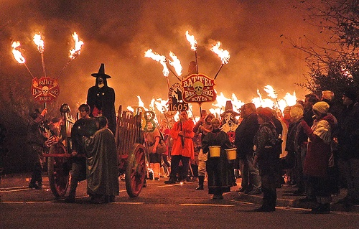

Slide 20
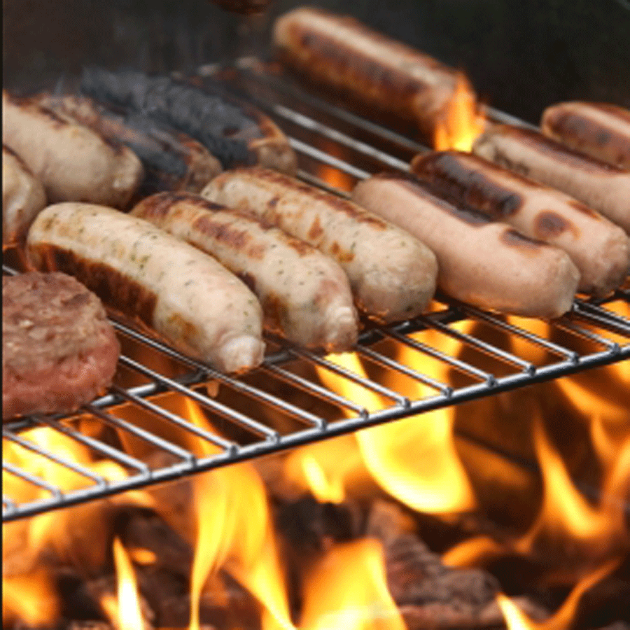
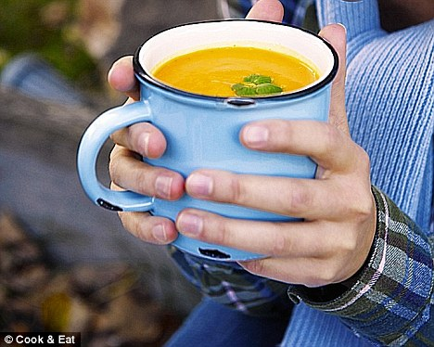
Traditional food
Toffee apples
Jacket potatoes
Creamy
tomato/carry
soup
Sausages

Slide 21
