Slide 1
My family

Slide 2
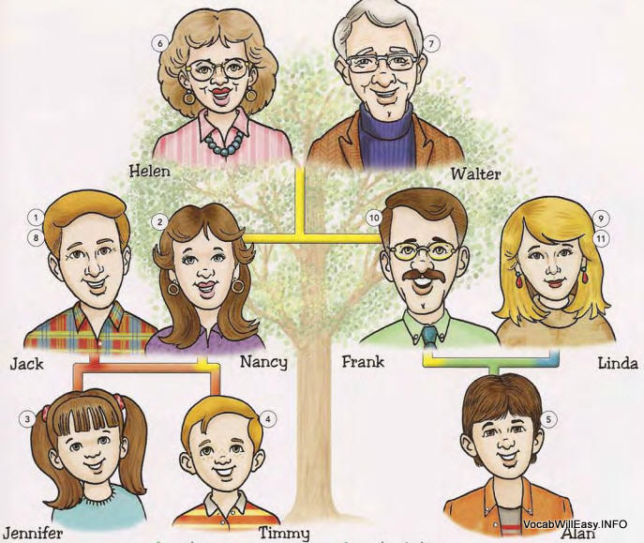
Linda’s family
mother
father
brother
sister
son
nephew
neice

Slide 3
Answer the questions
Have you got a mother?
Have you got a father?
Is your mother elder than your father?
Have you got a sister?
How many sisters have you got?
How old is your sister?
Have you got a brother?
What is his name?
Have you got an aunt?
Have you got an uncle?

