Slide 1
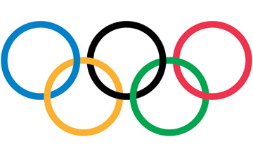
Olympic Games

Slide 2
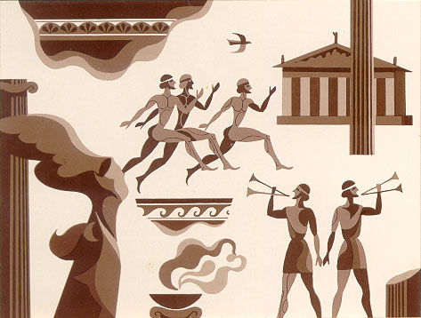
The Olympic games are known as the worlds
greatest international sports games.
The Olympic Games have
a very long history.
They began in
776 BC
in _______ .
Greece

Slide 3
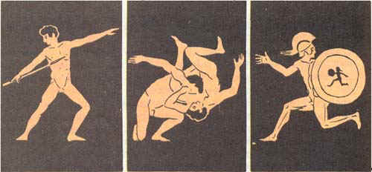
The Olympic Games took place every ____ years.
For the period of the Games all the war ________. So the Olympic Games became the symbol of peace and friendship.
four
stopped

Slide 4
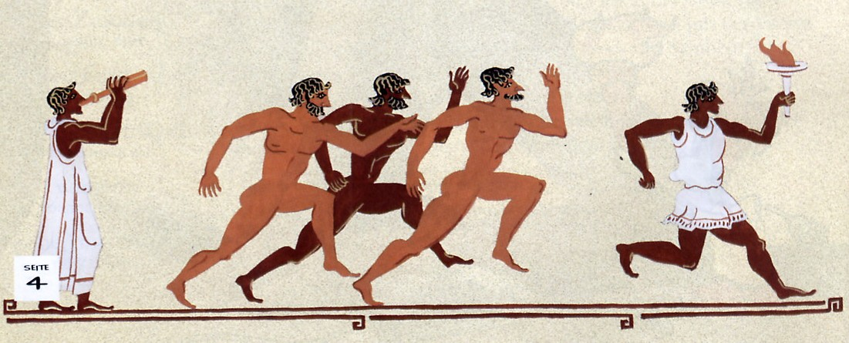
men
The games were for ____ only. Greek women were forbidden even to attend the Olympics.

Slide 5
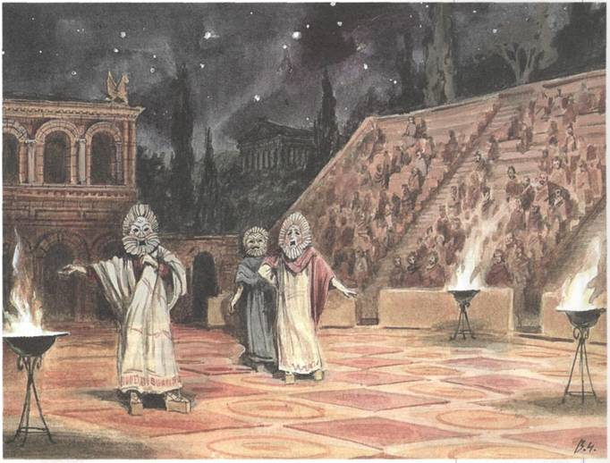
These games were part of a festival held in honor of the God Zeus at the place called Olympia.

Slide 6
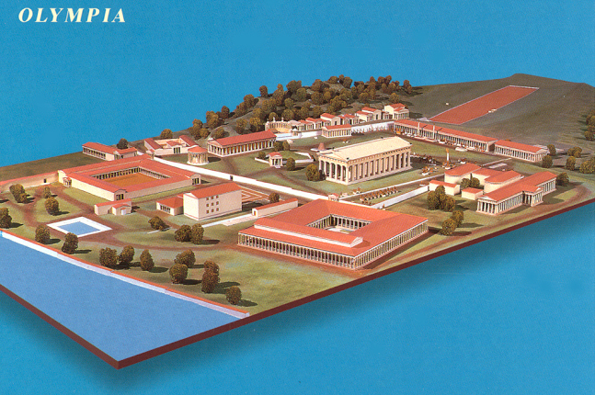
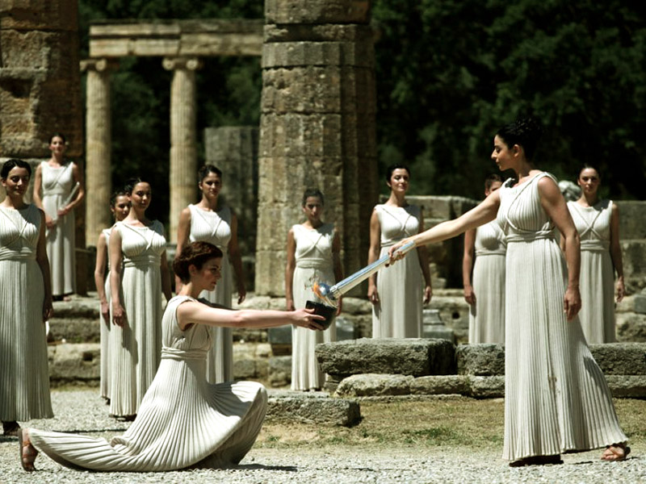
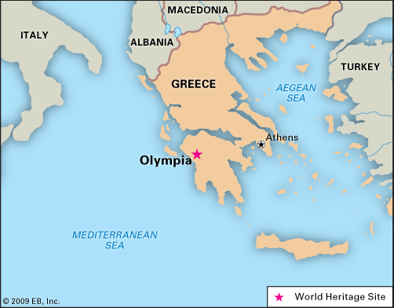
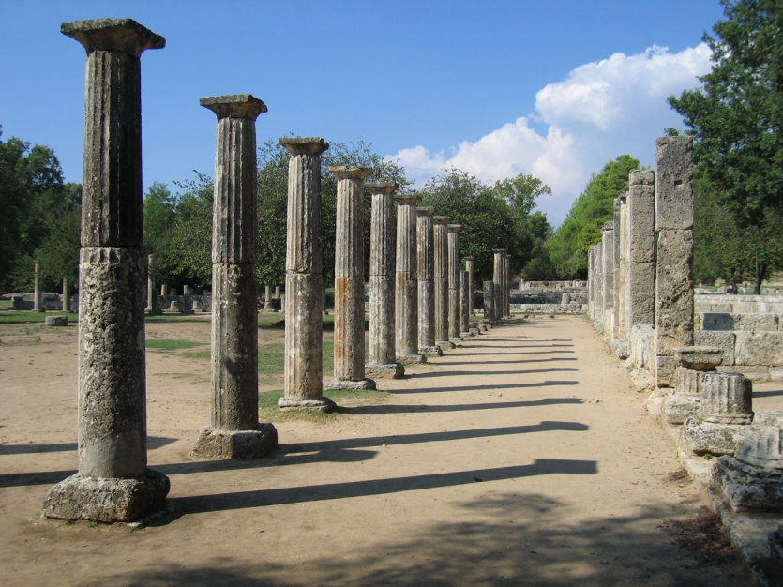
Olympia is located in the northwestern part of the Peloponnese peninsula.

Slide 7
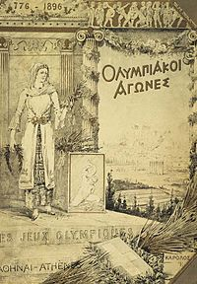
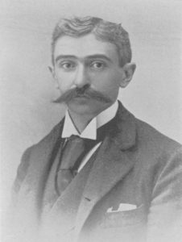
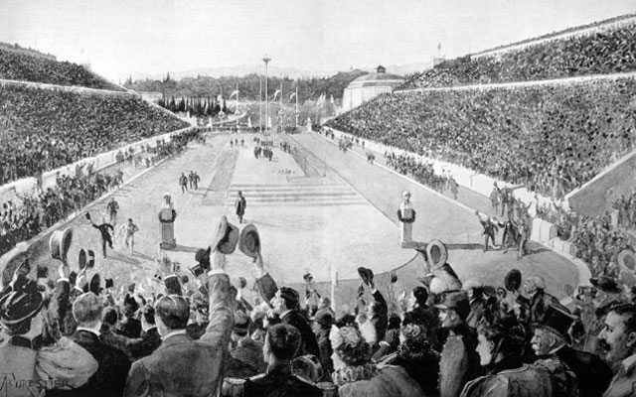
In 394 AD the Games were abolished.
In 1896 the modern Olympic Games were renewed. They took place in Greece to symbolize the continuation of the centuries-old tradition.

Slide 8
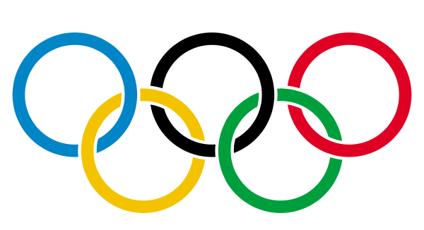
The Olympic flag:
colours symbolize the ______________ united into the Olympic movement.
The blue ring symbolizes _______ , the black ring – ______ , the red ring – ________, the yellow ring – _____ , the green ring – ________.
five continents
Europe
Africa
America
Asia
Australia

Slide 9
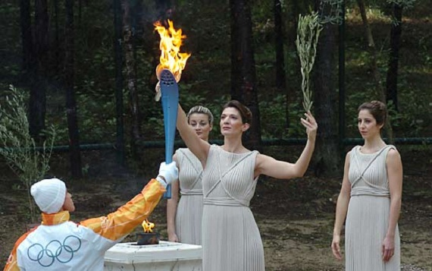
The Olympic flame is the traditional attribute of the Olympic Games. It’s a symbol of peace among people

Slide 10
The Olympic motto
The Olympic motto in Latin is “Citius, altius, fortius”.
In English it’s “Faster, higher, stronger”
The best sportsmen are awarded medals.
silver, gold and bronze

Slide 11
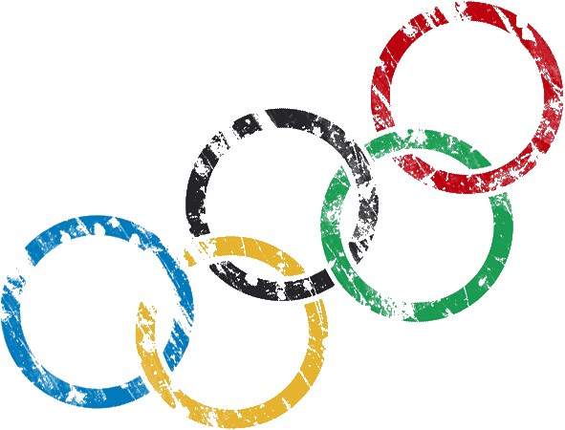
The Olympic Games
QIUZ

Slide 12
The Ancient Games
were first held in:
1) Italy 3) Greece
2) Germany 4) Spain
The first of the Modern Olympic Games were held in:
1) London 3) Rome
2) Barcelona 4) Athens

Slide 13
The first of the Modern Olympic
Games were held in:
1) 1776 3) 1906
2) 1896 4) 1916
The Olympic Games are held every:
1) 2 years 3) 6 years
2) 4 years 4) 8 years

Slide 14
An Olympic symbol is:
1) 4 interlaced squares
2) 5 interlaced rings
3) 3 interlaced hearts
The 1980 Summer Olympics
were held in:
1) Los Angeles 3) Moscow
2) Montreal 4) Atlanta

Slide 15
The 2012 Summer Olympic Games were held in:
1) London 3) Salt Lake City
2) Sydney 4) Beijing
The 2014 Winter Olympic Games were held in:
1) Canada 3) Russia
2) The UK 4) the USA

