Slide 1
Where are the stars?

Slide 2
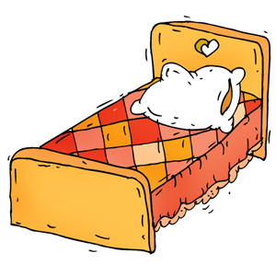
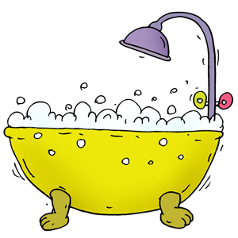
The sound [u:]
Let’s listen!
-oo-
room
+ room = bedroom
bed
+ room = bathroom
bath

Slide 3
Let’s read!
That is a ship.
This is a box.
This is a key.
A key is on the box.

Slide 4
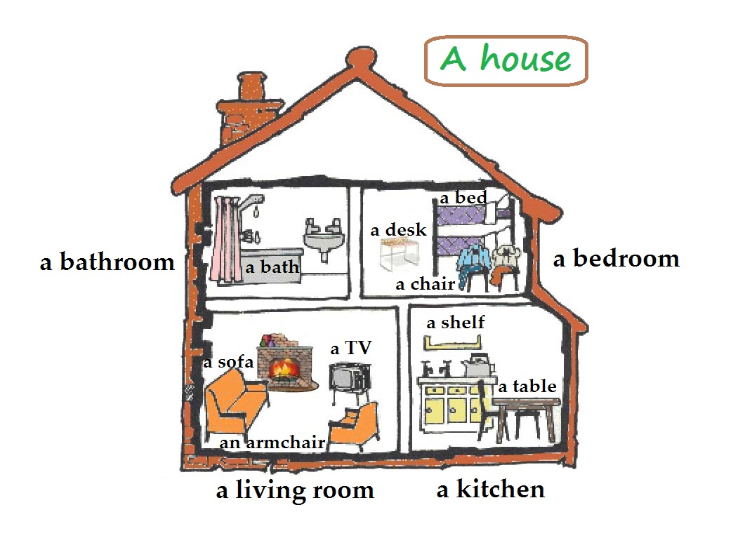

Slide 5
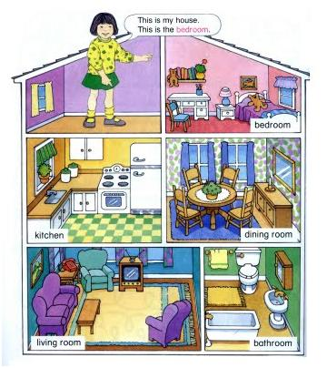
Where is ... ?
the brown table
the purple sofa
the white bath
the blue armchair
the white bed
the yellow carpet

